Slide 1
Welcome to Network Security
EN.600.444/644
Spring 2019
Dr. Seth James Nielson

Slide 2

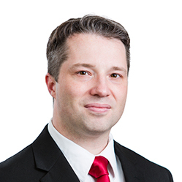



About the Instructor

Slide 3
About the Course
Network Protocol Stacks
PROGRAMMING
NETWORK SECURITY
Network architecture
Network Attacks
Cryptographic Protocols

Slide 4
Philosophical Overview
TECHNICAL
NON TECHNICAL
THEORY
PRACTICE
EDUCATED
SKILLED
TEACHER
STUDENT

Slide 5
The 5 Orders of Ignorance
0th Order: Known Knowns
1st Order: Known Unknowns
2nd Order: Unknown Unknowns
3rd Order: Unknown methods for discovering unknown unknowns
4th Order: Unknown methods for exploring the orders of ignorance
(Adapted from Phillip Armour, “The Five Orders of Ignorance”)

Slide 6
The 5 Orders of Ignorance
0th Order: Known Knowns
1st Order: Known Unknowns
2nd Order: Unknown Unknowns
3rd Order: Unknown methods for discovering unknown unknowns
4th Order: Unknown methods for exploring the orders of ignorance
(Adapted from Phillip Armour, “The Five Orders of Ignorance”)
SKILL
EDUCATION

Slide 7

Student + Teacher
MEDIOCRITY
Sufficient Time
Sufficient Sacrifice
Sufficient Humility
SHARED VISION

Slide 8

Facing the Challenge
Final Exam: Teach it!
Three MAJOR labs
Spec Drafting
Technical Reading + Quizes
This Photo by Unknown Author is licensed under CC BY-SA-NC

Slide 9
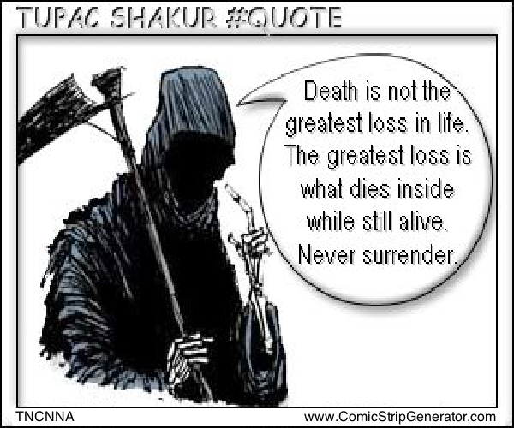
But You CAN Do It!
I BELIEVE in YOU
I want you to SUCCEED!
I want you to feel the RUSH and LOVE it!
This Photo by Unknown Author is licensed under CC BY-NC-ND

Slide 10
But Understand the Risks
A “B” (or maybe even a “C”) is not the greatest loss in your academic career. The greatest loss is an “A“ on your transcript, but a “B“ (or maybe even a “C”) in your heart and mind.
Dr Nielson #Quote

Slide 11
This Class is NOT for You If…
Grades matter more than learning
You’re not willing to take risks
You’re not willing to work hard
You’re not willing to be uncomfortable

Slide 12
This Class IS For You If…
You want to increase your awesomeness
You want to think in ways you’ve never thought before
You like taking on challenges
You understand both figuring things out for yourself and the need to get help

Slide 13
My Job Is Enablement
Retake/Fallbacks
Useful Lectures
Office Hours
Help Sections

Slide 14
Policy #1: Communication
If you are having trouble, you will tell me EARLY.

Slide 15
Policy #2: Class is for Discussion
I will not cover every detail in class. You must learn the core individually.

Slide 16
Policy #2(a): Learn Before Class
Study assigned readings before class. Bring Questions/Insights.

Slide 17
Policy #2(b): TA/Teacher Help
If you did not fully understand a class topic, see a TA/Teacher for HELP.

Slide 18
Policy #3: The World is your Textbook
Some readings are unspecified. Find materials by SEARCH.

Slide 19
Policy #4: Laptops
Bring laptops to class every day. Use them for class assignments ONLY.

Slide 20
Policy #5: Cheating
Review details in the Syllabus. Don’t Do It.

Slide 21
Class Resource #1: Campuswire
Similar to Piazza, but I think it might be better (experiment)
For most questions, please post to Campuswire instead of sending email
Responding to an email helps 1, responding on Campuswire helps class
You will receive an invite

Slide 22
Class Resource #2: Github
github.com/CrimsonVista/NetworkSecuritySpring2019
You need to share a PRIVATE github repo with Teacher/TA for this class
Please review instructions for organizing directories within the repo
Make sure you have academic status at GitHub so you can collaborate

Slide 23
Class Resource #3: Help Sections
Out-of-class reinforcement, hands-on help for new concepts
Please let the teaching staff know on Campuswire good times for these
Intended to help individuals that are behind catch-up

Slide 24
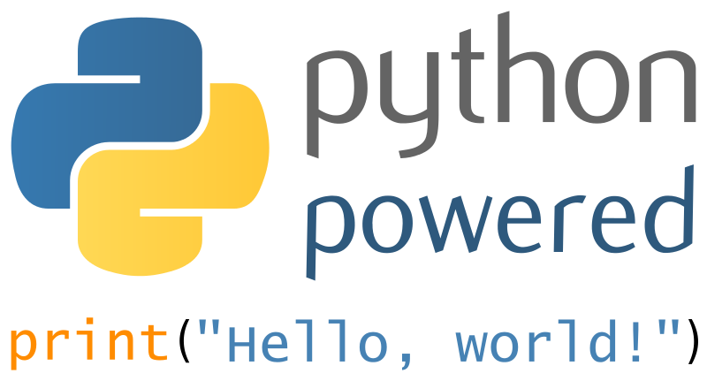
Next Class Preview
This Photo by Unknown Author is licensed under CC BY-SA

